Slide 1
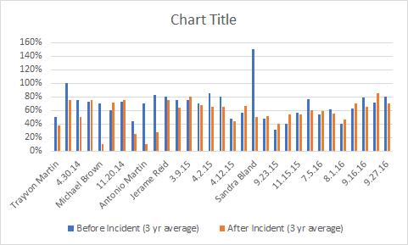
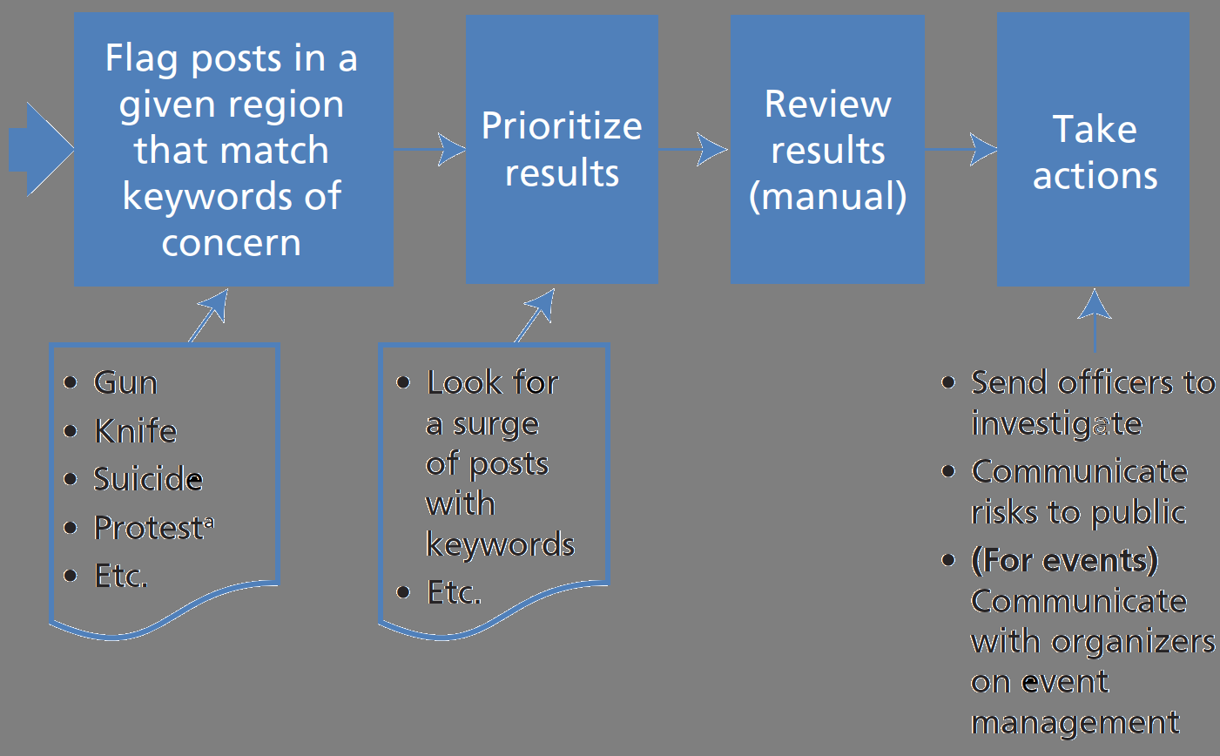
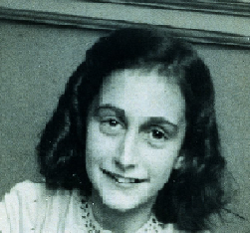

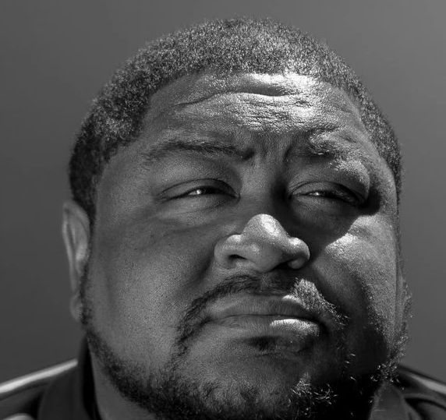
Implicit Biased in Predictive Policing
DSC 500 Group 3: Harold Anderson, Kiana Gonzalez-Rodholm, and Joseph Ruiz
Introduction:
Predictive policing methods are used throughout the US to try and predict and stop crime. With the use of predictive algorithms, police can find potential crime "hot spots" and dispatch officers appropriately. The use of such methods however have shown an ingrown biased towards lower income areas and encode racial profiling.
Why is this data Science?
Police Agencies across the US and UK use predictive algorithms such as Predpol which use internal data collected from previous crime reports to predict where new crimes are likely to occur. There have been other instances where predictive data have been used to find out people who are more likely to commit crimes or who may be prone to violent or gun-related crimes. Data has also been analyzed by our group to show that when racial-based killings occur, policing in that area is reduced which may be a cause of continued racial biased.
Black Lives Matter and Predictive Policing
EACH DATE REPRESENTS A racially-motivated police killing IN CITIES ACROSS THE US FROM PREDPOL AND OVERPOLICING. THE THREE YEARS FOLLOWING THESE EVENTS under-policing OCCURS. This allows racial biases to fester.
These two percentages are ratios of solved homicide cases per year to total reported homicides, thus the smaller the percentage the less the number of solved homicide cases.
BUT AFTER INFAMOUS blm EVENTS LIKE THE SLAYINGS OF MICHAEL BROWN, ANTONIO MARTIN, AND SANDRA BLAND, THESE INCIDENTS OF UNDERPOLICING FOLLOWING A RACIAL KILLING ARE IMPROVING.
Predictive Policing with Social Media
Which one is the criminal?
Harrisburg University, researchers claimed to "predict if someone is a criminal based solely on a picture of their face", with " 80 percent accuracy and with no racial bias.[4]
Literature/Standpoint:
Albert Meijer & Martijn Wessels (2019) Predictive Policing: Review of Benefits and Drawbacks, International Journal of Public Administration, 42:12, 1031-1039, DOI: 10.1080/01900692.2019.1575664
Benbouzid, B. (2019). Values and Consequences in Predictive Machine Evaluation. A Sociology of Predictive Policing. Science & Technology Studies, 32(4), 119–136.
Bonn, S. (2017, April 09). Why Elite White-Collar Criminals Are Rarely Punished. Retrieved June 17, 2020, from https://www.psychologytoday.com/us/blog/wicked-deeds/201704/why-elite-white-collar-criminals-are-rarely-punished
Chohlas-Wood, A., & Levine, E. S. (2019). A Recommendation Engine to Aid in Identifying Crime Patterns. INFORMS Journal on Applied Analytics, 49(2), 154–166. https://doi-org.ezproxy.bellevue.edu/10.1287/inte.2019.0985
Howard, A., & Borenstein, J. (2018). The Ugly Truth About Ourselves and Our Robot Creations: The Problem of Bias and Social Inequity. Science & Engineering Ethics, 24(5), 1521–1536. https://doi-org.ezproxy.bellevue.edu/10.1007/s11948-017-9975-2
Lee, Y., SooHyun, O., & Eck, J. E. (2020). A Theory-Driven Algorithm for Real-Time Crime Hot Spot Forecasting. Police Quarterly, 23(2), 174–201. https://doi.org/10.1177/1098611119887809
Spencer, K. B., Charbonneau, A. K., & Glaser, J. (2016). Implicit Bias and Policing. Social & Personality Psychology Compass, 10(1), 50–63. https://doi-org.ezproxy.bellevue.edu/10.1111/spc3.12210
Swan, S. L. (2020). Discriminatory Dualism. Georgia Law Review, 54(3), 868–925.
White, M., & Escobar, G. (2008). Making good cops in the twenty-first century: Emerging issues for the effective recruitment, selection and training of police in the United States and abroad. International Review of Law, Computers & Technology, 22(1/2), 119–134. https://doi-org.ezproxy.bellevue.edu/10.1080/13600860801925045
Wilson, D. (2020). Predictive Policing Management: A Brief History of Patrol Automation. New Formations, 98, 139–155. https://doi-org.ezproxy.bellevue.edu/10.3898/NEWF:98.09.2019
Conclusions:
IN using past data to mold these predictive methods, police systems are inherently ingesting biased into an already unjust system. They end up becoming a self-fulfilling prophecy that results in further condemning of minorities and those in poverty-stricken areas. With more transparency to the public, interdisciplinary teams, less biased data, and fair and accurate data analysis, criminal justice systems can begin to have a more tolerant and helpful tool for aiding in the minimalization of crime in the US. BY analyzing past data we can also uncover more failed policing methods that incur racial biases.
Acknowledgements:
We would like to thank those who are advocating for change in the criminal system to have predictive policing methods become fair and unbiased towards specific groups. We thank those working towards building a fair and just system in hopes to keep communities safe and reduce crime as well as not using additional unnecessary funding.
Notes:
We can make the reference section smaller
Idea: make a graphic that shows what an algorithm is looking for in a social media post(one as a potential threat to the public) --has to be a fake template maker we can use(Memes) have picture of people with the question can you spot the criminal --JR will make the meme JR will have list of example that would Predictive policing make better(at least in draft sense)
Using Social Media and Social Network Analysis in Law Enforcement(graphic might change latter I looking for made fb post, I can still make but we need more ML models papers
Something new – A deep learning model to predict criminality using image processing ( https://medium.com/@CoalitionForCriticalTechnology/abolish-the-techtoprisonpipeline-9b5b14366b16 )[4]
Better:
Transparency
Community input on applied action/policy of the ML algorithms
More internal data on policing misconduct
Lack of data means a lack of possible ML tool to catch bad apples (https://fivethirtyeight.com/features/we-now-have-algorithms-to-predict-police-misconduct/)
Leveler
Multidisciplinary team
Litmus-type
for discrimination simply by analyzing the data going into a program and the decisions coming out the other end
The domain is the whole criminal justice system
Included discussion on how historical laws and policy design in analysis the data
Extreme venting(similar to Homeland or FBI) in the hiring of police officers
JR still has convert bullet list to a paragraph. Add any thoughts
Harrisburg University, researchers claimed to “predict if someone is a criminal based solely on a picture of their face,” with “80 percent accuracy and with no racial bias.”
Anne Frank(https://www.annefrank.org/en/anne-frank/main-characters/anne-frank/)
Nelson Mandela (http://www.radiodiaries.org/becoming-nelson-mandela/)
Robert Julian-Borchak Williams(https://www.nytimes.com/2020/06/24/technology/facial-recognition-arrest.html)

